Slide 1

Spotted Python Week 4 Tutorial
For and While loops
Creating subplots

Slide 2

For and While Loops
For loops repeat a piece of code while changing an input variable
While loops repeat a piece a code until a certain condition is met
Complete Exercise 1

Slide 3
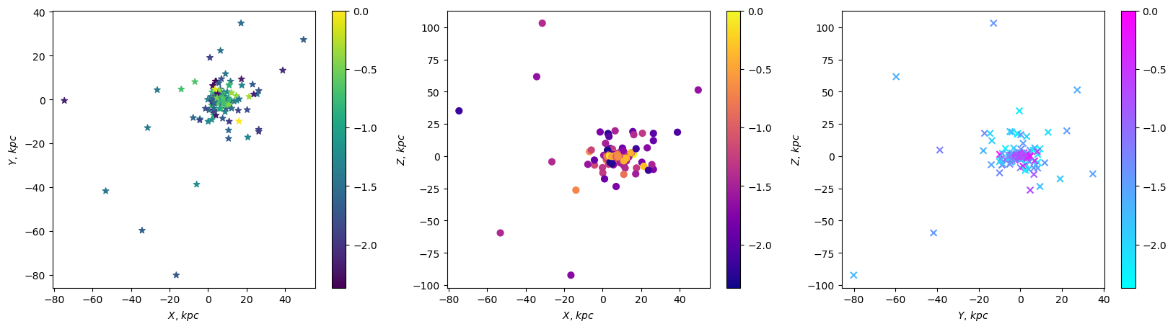
Milky Way Globular Clusters
Reminder that the assignment data can be found under assessment hub → computational assessment data
For the working example, use the harris_combined.csv provided
Colouring the GC by [Fe/H], what trends do we see?

Slide 4
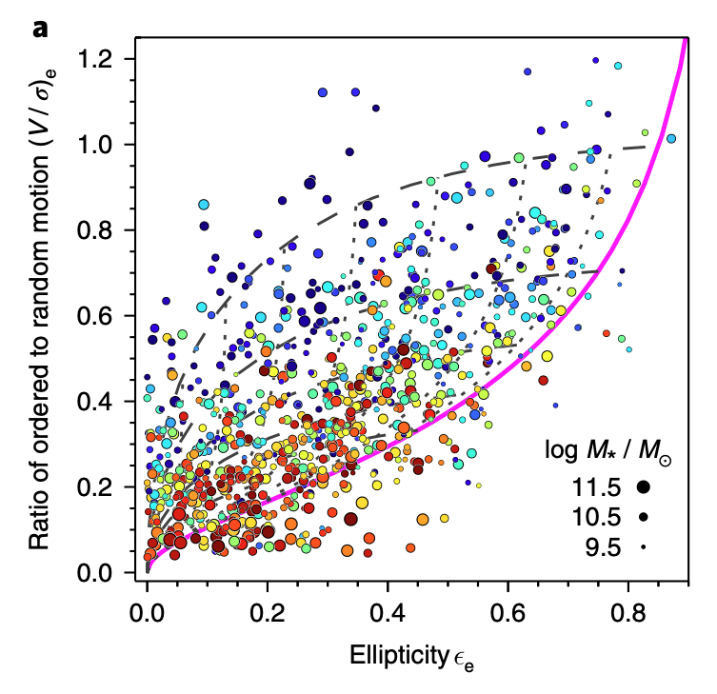

SAMI
Relationship between $V/σ$ and $ε$ (Cappellari, 2007)
$${\left(\frac{V}{σ}\right)}_{e}=\sqrt{\frac{\left(0.09+0.1ε\right)ε}{1−ε}}$$
Try to recreate this figure from van de Sande, 2017 (Exercise 2)

Slide 5
Group Meeting Time

